Slide 1
ONLINE HEALTH TRACKER
Chandrika Machavarapu
HAP 618

Slide 2
Project Description:
The notion behind the project is to develop an online health tracker which helps the users to track the characteristics like calories they need to burn or gain in order to maintain the normal weight. The primary step is to create an account by providing email, username and password then the user inputs name, age, height and weight and then the persons BMI is calculated and then it results in the weight which is more than the usual one and show the status of obese. It will also ask the person for the calories input they takes on daily basis then the BMR is calculated and it shows the actual BMR value and suggested BMR value in order to maintain normal weight. The data is recorded users can access the historical data in the form of both table and graph and see how the values are changed over time.

Slide 3
Software’s Used :
Python (2.6)
Flask(Python Frame work)
HTML
CSS
Java script (JS)
My SQL database
Xampp software
Data Base Name :
health_tracker
Database Tables:
User
Personal Profile
Dashboard

Slide 4
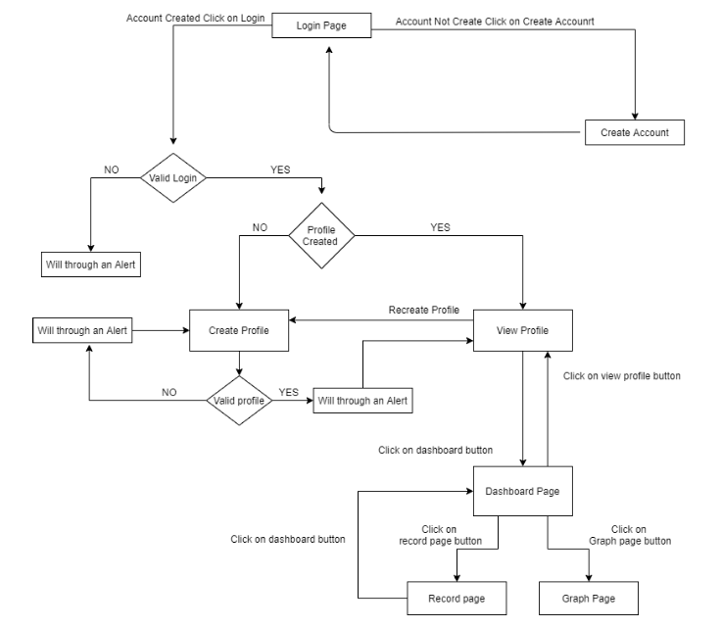

Slide 5
Project Outline:
HTML and CSS are used for frontend pages
Python is used for backend codes
Xampp server is used for database
Using Flask routes we are connecting frontend HTML and Backend Databases where Flask Routes are written in Python.

Slide 6
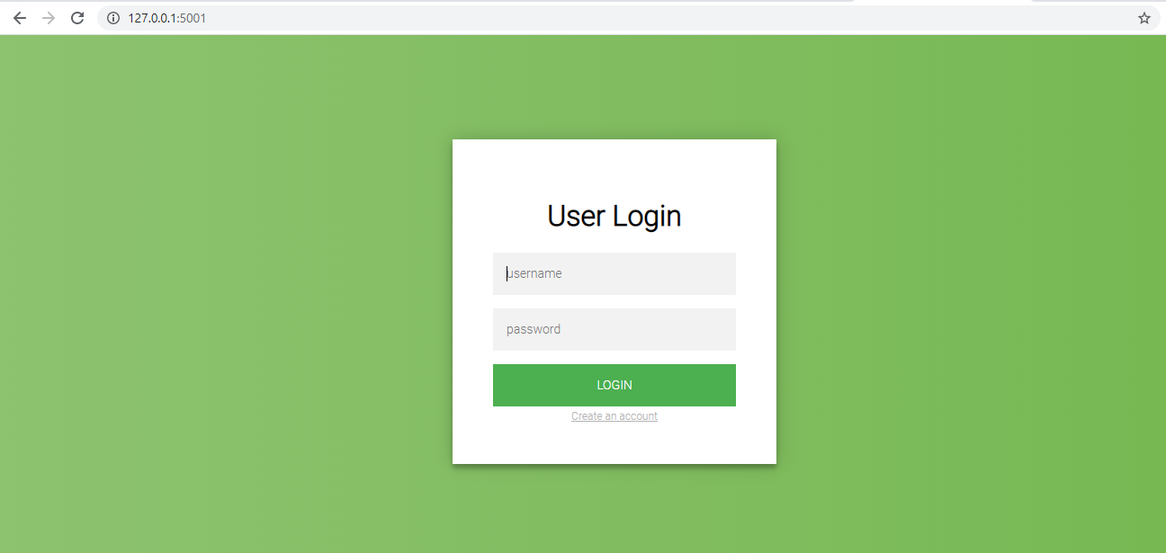
Login Page:
User Logins to the application using his/her login credentials.
If new user wants to login he/she must create an account with the link provided below ‘LOGIN’ button

Slide 7
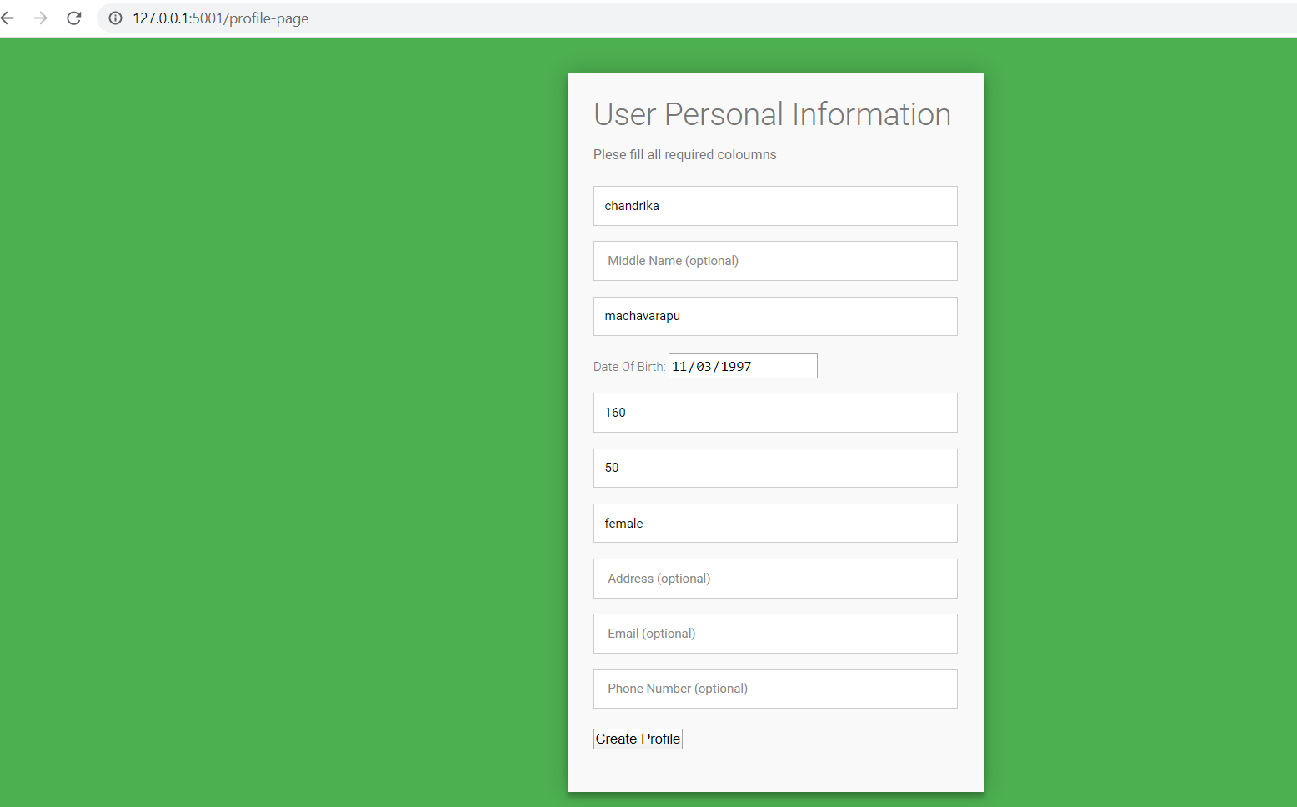
User Profile Creation:
After Login user needs to create his/her own profile giving the following details mentioned in snapshot.

Slide 8
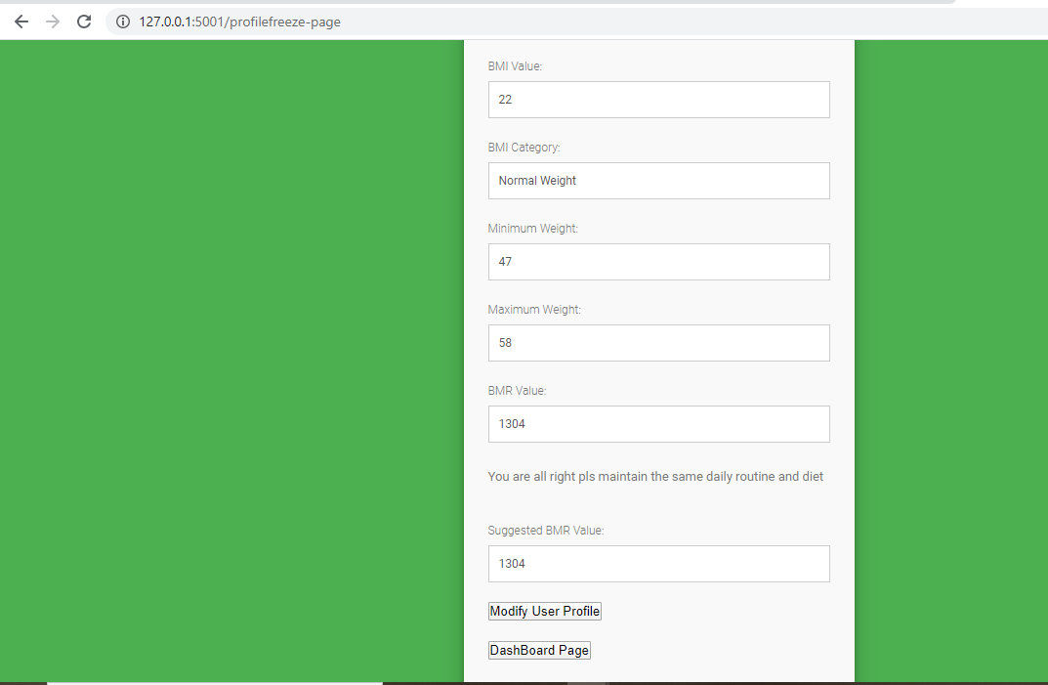
Output Page:
When User created profile with mandatory data then this output will be shown .
Basically the outputs consists of :
BMI value
BMI Category
Maximum Weight
Minimum Weight
BMR value
Suggestions
Here there are two Buttons
Modify User Profile.
To recheck the BMI and BMR value.
2. Dashboard Page
- To check the Results in Graphs and tables.

Slide 9
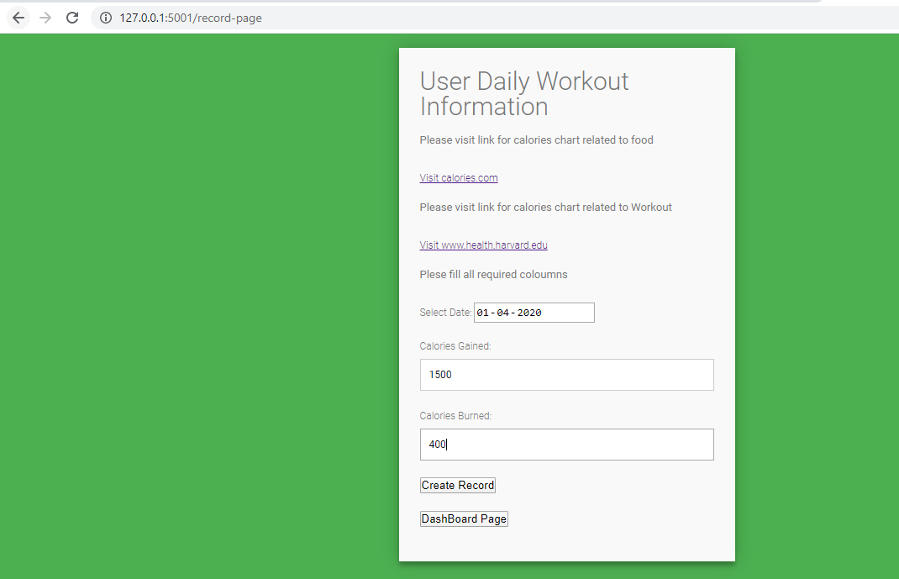
User Daily Workout Inputs:
User Inputs his daily workout information like Number of calories gained and number of calories burnt.
All this daily information of that particular user will be stored in database tables.

Slide 10
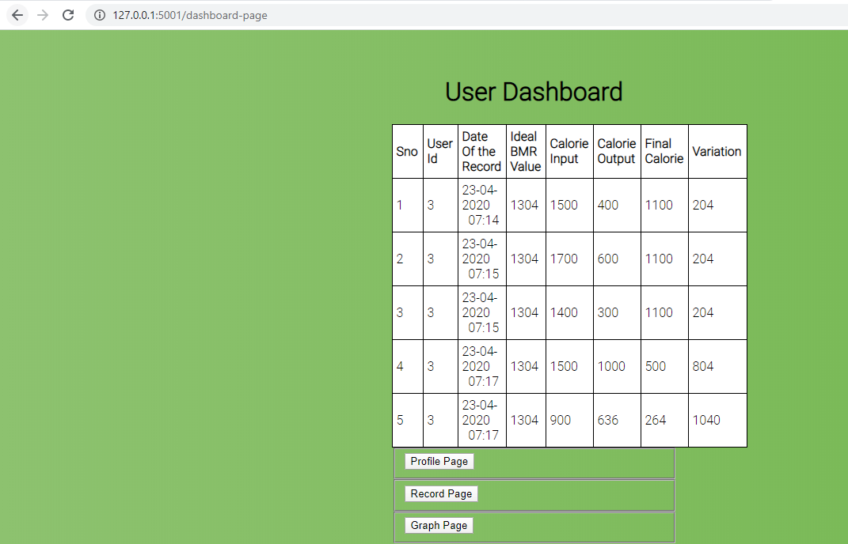
User Dashboard:
All the Information he recorded each day will be shown as a table format.
This table data is user respective.
From here we can navigate to:
Profile Page : To re-enter height and weight in order to calculate BMI,BMR
Record Page: To enter Daily workout Information
Graph Page: All this Information is shown is graphs for easy understanding.

Slide 11
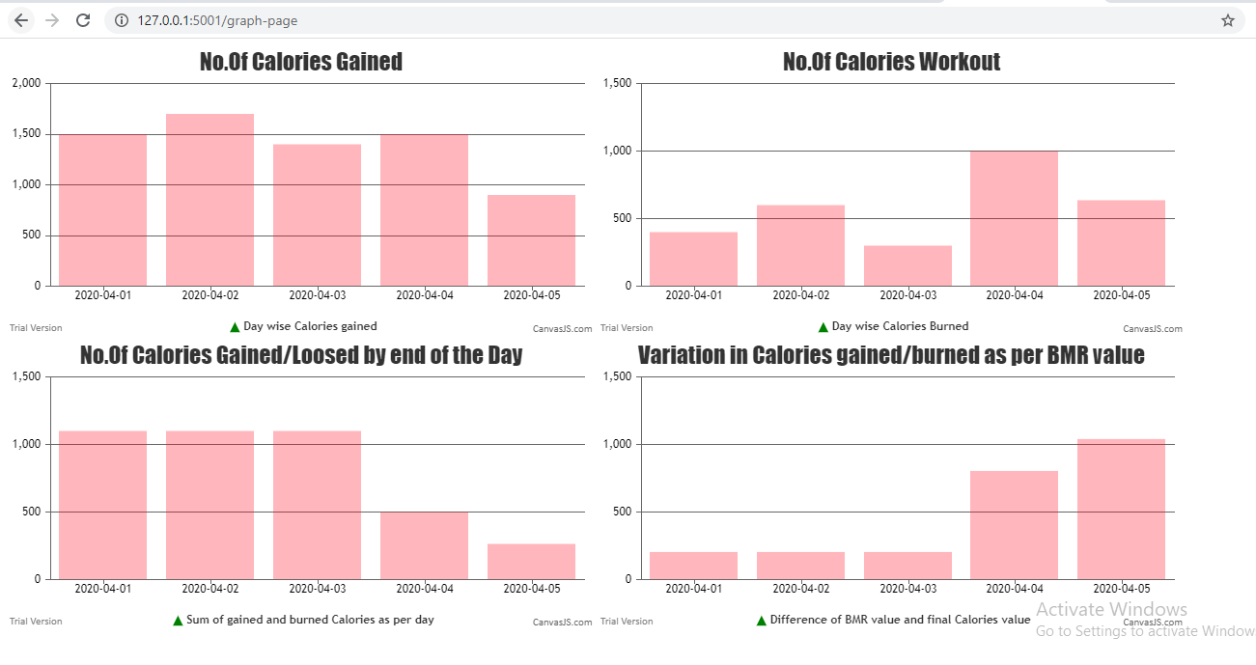
Graphs:
Each users information is presented in different graphs as shown in snapshot.

Slide 12
Thank you

